Slide 1

Google Play Store App Project
EDA of Google Play Store App Dataset
Created & Presented by :
Kanishka SejWal
Jayant Kapoor
Kashish

Slide 2
Introduction
The Google Play Store is home to millions of Android applications spanning various categories, user bases, and functionalities. This project focuses on performing an Exploratory Data Analysis (EDA) of a real-world dataset containing metadata of apps listed on the Play Store. The aim is to uncover key patterns, clean the data for analysis, and visualize trends that impact app popularity, user engagement, and overall performance using Python-based data science tools.

Slide 3
Objective
To perform Exploratory Data Analysis (EDA) on the Google Play Store dataset.
To uncover insights into app characteristics such as category, ratings, reviews, price, installs, and content rating.
To clean and preprocess the data for accurate analysis.
To visualize trends and patterns that influence app popularity and performance.
To strengthen understanding of Python libraries like Pandas, Matplotlib, and Seaborn for data analysis and visualization.

Slide 4
Table of Contents
Introduction & Objective
Dataset Description
Step 1: Understanding the Dataset
Step 2: Data Cleaning
Step 3: Exploratory Data Analysis (EDA)
Step 4: Visual Insights
Tools Used
Outcomes & Insights
Conclusion

Slide 5
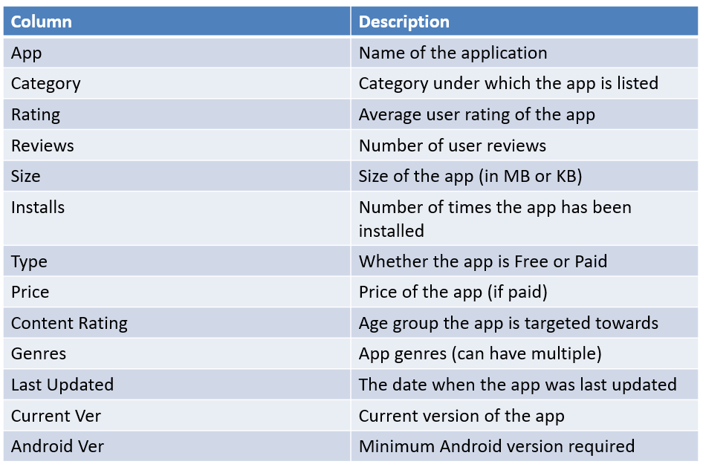
Dataset Description
The dataset used for this project is a collection of metadata from apps published on the Google Play Store. It contains information about:

Slide 6
Step 1 - Understand the Dataset
1.1 Load dataset using Pandas?
Loading the dataset is the first step in Data Understanding, it is done by importing the libraries and then loading the dataset.
Importing necessary libraries( matplotlib, numpy , seaborn and pandas)
Then we load the dataset using pd. read command.
df=pd.read_file format(‘filename.extension’)
df
it shows us the loaded dataset.
1.2 Display basic info using df.head(), df.info(), df.describe()?
df.head(): It is used to display the top 5 rows of the dataset.
By using this command we saw the top displayed rows.
df.info(): It is used to display the data type of the dataset.
this command shows us the info of data type and Data columns.
df.describe(): it is used to display the descriptive or statistical summary of the dataset.
this shows us the descriptive summary of the dataset
1.3 Identify columns with missing values using df.isnull().sum()?
df.isnull().sum(): it is used to identify null values in the dataset, it shows us the null values .
df.duplicated(): it is used to show duplicates present in the dataset.
1.4Check unique values for categorical columns like Category, Type, and Content Rating?
df.[‘column_name’].unique(): it is used to show unique values present in the columns.
df.nunique(): To check the no of unique values present in the dataset.

Slide 7
Step 2 - Data Cleaning
2.1 Remove duplicates and rows with missing target values
df.drop_duplicates(): it is done to drop the duplicate values of the dataset.
df.fillna(‘column_name’): it is done to fill the missing values of the dataset with mean or any other value.
2.2 Convert 'Installs' and 'Price' to numeric values
df['Installs'].fillna(df['Installs'].mean(),inplace=True)
using this formula we can convert float or other dtype value to numeric.
2.3 Standardize app sizes to MB/KB
def convert_size(size):
if isinstance(size, str):
size = size.strip()
if size.endswith('M'):
return float(size[:-1])
elif size.endswith('k'):
return float(size[:-1]) / 1024 # Convert KB to MB
elif size.lower() == 'varies with device' or size == '':
return np.nan
return np.nan
df['Size_MB'] = df['Size'].apply(convert_size)
using this we can convert one string value to other string format.
2.4 Remove outliers in Rating column
sns.boxplot(x=df['Rating’])
with seaborn we can create boxplot for outlier detection and and drop outliers in the column.
Outliers can be Removed from 'Rating' using the IQR method.

Slide 8
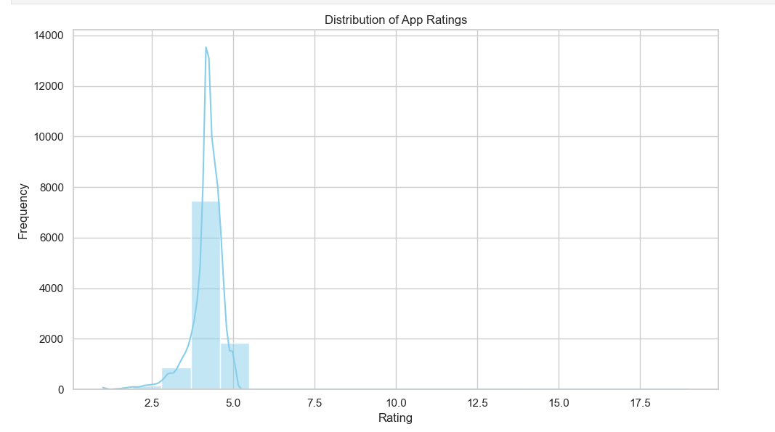
Step 3 - Basic EDA
Distribution plot of Ratings
Peak at 5.0: Most apps seem to receive high ratings, particularly around 5.0, suggesting a general trend of positive user feedback.
Right-skewed distribution: The majority of ratings cluster between 4.0 and 5.0, while higher ratings (above 5.0) are far less frequent.
Smooth KDE overlay: This helps visualize the overall shape of the distribution, reinforcing the concentration of ratings near the highest values.
User satisfaction trends: Since ratings are predominantly high, it could imply that either users are generally satisfied with apps or that lower-rated apps are less commonly reviewed.

Slide 9
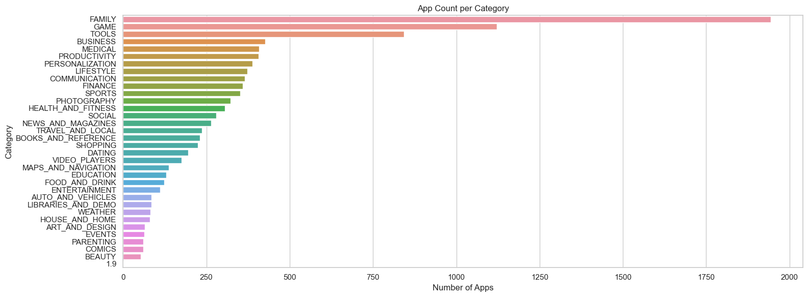
Count Plot for Categories
Most popular categories:
The most apps are in FAMILY, followed by GAME and TOOLS. These categories likely have high user demand and engagement.
BUSINESS, MEDICAL, PRODUCTIVITY, and PERSONALIZATION are also substantial, reflecting utility-based app growth.
Least populated categories:
BEAUTY, COMICS, and PARENTING have fewer apps, indicating niche markets with lower app production.
WEATHER, ART_AND_DESIGN, EVENTS also appear to have lower app counts.
Market implications:
Developers may focus on high-growth categories like FAMILY and GAME due to demand.
Underrepresented categories could offer opportunities for innovation with fewer competitor

Slide 10
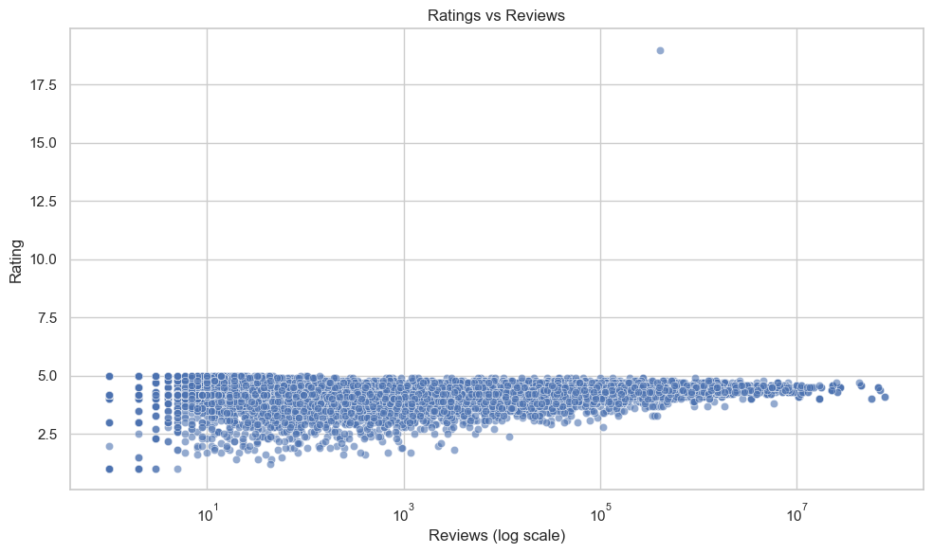
This scatter plot visualizes the relationship between app ratings and the number of reviews, using a logarithmic scale for reviews.
Key insights: Clustered ratings:
Most apps are rated between 2.5 and 5.0, showing a general tendency toward mid-to-high ratings.
Few apps fall below 2.5, indicating that extremely low ratings are uncommon.
Logarithmic scale impact:
The spread of points suggests that apps with fewer reviews are more widely dispersed in ratings.
Apps with higher reviews tend to have stable ratings, likely because larger review samples balance extreme ratings.
Outlier alert:
There's one outlier above 17.5, which seems unusual—it could be a data error or a special case.
Market implications:
Apps with high ratings and high reviews tend to be more established and trusted by users.
Low-rated apps with many reviews might face reputation issues or offer inconsistent experiences.

Slide 11
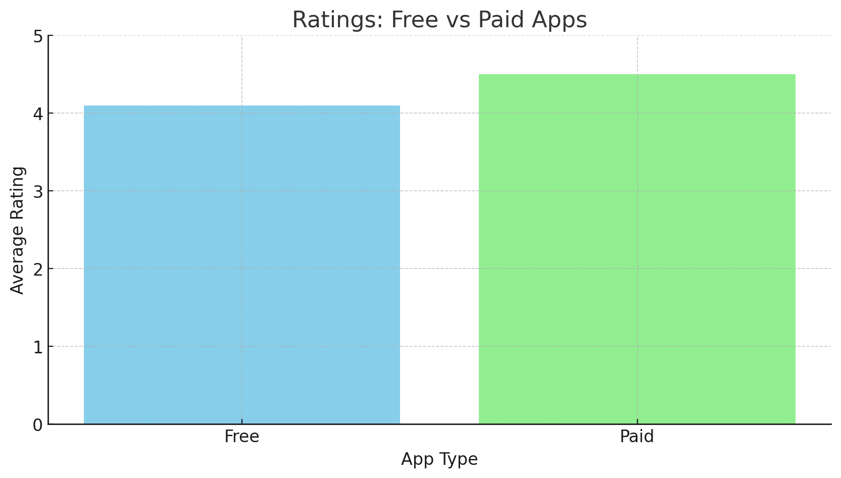
This bar plot compares the ratings of free apps vs. paid apps, helping to analyze their relative quality based on user feedback.
Paid apps have a higher average rating (~4.5) compared to Free apps (~4.1). 🔹 User satisfaction seems to be better for Paid apps — possibly because paid apps offer better quality, fewer ads, and more complete features. 🔹 Free apps, while popular, might compromise on user experience due to ads, limited features, or frequent bugs.
Paid apps deliver a slightly superior user experience, reflected by their higher average ratings compared to free apps.

Slide 12
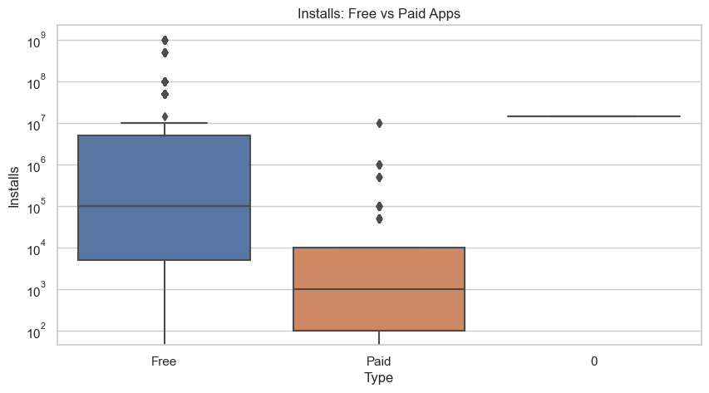
This box plot compares the number of installs for free and paid apps, helping to highlight their market reach.
Free apps dominate:
The median installs for free apps are around 10⁵, while for paid apps, the median is much lower at 10³.
Free apps generally attract a larger user base due to zero cost barriers, making them significantly more accessible.
Wider spread for free apps:
The interquartile range (IQR) for free apps spans 10⁴ to 10⁶ installs, whereas for paid apps, it's only 10² to 10⁴ installs.
The presence of high-outlier free apps (above 10⁷ installs) shows that some free apps achieve massive popularity.
Paid apps have fewer installs but stable engagement:
While they don’t achieve the same numbers as free apps, paid apps tend to be more niche, often attracting dedicated users.
A few paid apps above 10⁵ installs show that certain premium offerings do reach a large audience.
Market implications:
Developers must consider monetization strategies carefully—going free can maximize reach, but paid apps may attract quality-driven consumers.
User acquisition for paid apps requires strong branding, exclusive features, or superior performance to compete.

Slide 13
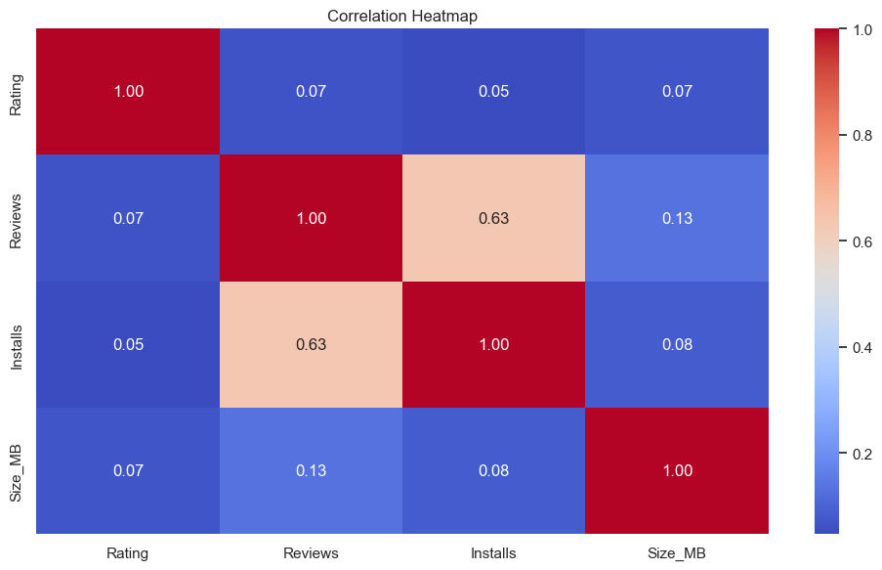
Step 4 - Visual Insights
This correlation heatmap visualizes relationships among key app variables like Rating, Reviews, Installs, Price, and Size_MB.
Strong correlation:
Reviews and Installs (0.63) have the highest positive correlation, meaning apps with higher installs tend to receive more reviews.
Reviews and Size_MB (0.13) shows a weak positive correlation, possibly indicating larger apps get slightly more user feedback.
Weak or negligible correlations:
Ratings and Installs (0.05) suggests that high installs don’t necessarily mean high ratings—popular apps don’t always have the best user experience.
Ratings and Reviews (0.07) implies that a higher number of reviews doesn’t strongly affect average ratings.
Missing correlations:
Price-related correlations are not shown, likely due to missing data points or limited variation in pricing.
Investigating Price vs. Installs and Price vs. Reviews could reveal insights into user behavior for paid apps.
Market implications:
Developers can focus on install strategies, as they strongly impact review volume.
Ratings remain independent, meaning app quality must be emphasized over sheer install growth.
App size may influence engagement but is not a dominant factor in reviews or installs.

Slide 14
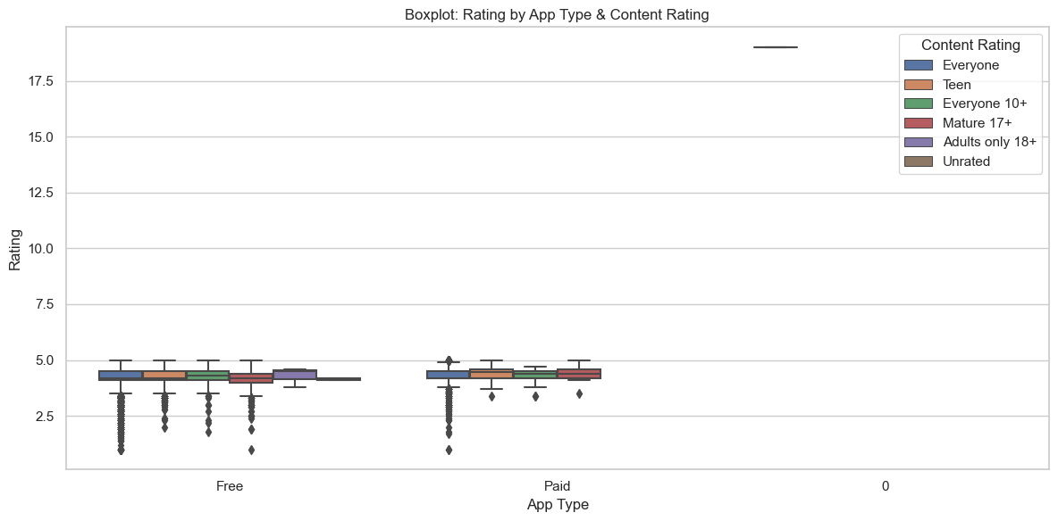
This box plot compares app ratings across different content ratings for Free and Paid apps.
Median ratings across content ratings:
Everyone-rated apps (both Free and Paid) have relatively high median ratings, suggesting general user satisfaction.
Teen and Mature 17+ apps have a wider rating spread, likely due to more subjective content preferences.
Adults Only 18+ apps show noticeable rating variation, but the sample size may be smaller.
Rating distribution differences between Free & Paid apps:
Paid apps seem more consistent with fewer extreme outliers, possibly due to better quality control.
Free apps have a broader rating spread, indicating mixed experiences from users.
Unusual outlier behavior:
There's an outlier rating above 17.5, which is unrealistic for standard app ratings (1–5 range). It might be a data error.
The presence of low-rating outliers for both Free and Paid apps shows some apps receive poor user feedback.
Market implications:
Developers targeting Teen & Mature content should focus on improving user satisfaction due to diverse opinions.
Paid apps tend to maintain higher consistency, making them reliable in certain categories.
Outlier ratings could indicate anomalies or errors in app rating systems.

Slide 15
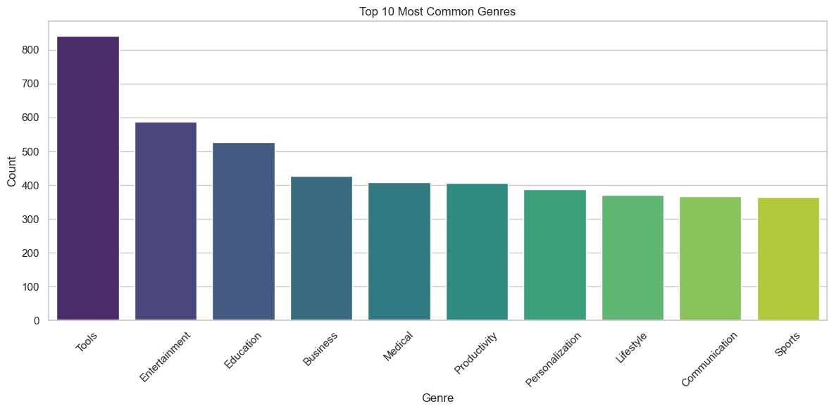
This bar chart displays the Top 10 Most Common Genres based on app count.
Most prevalent genres:
Tools leads with the highest count (over 800), suggesting strong demand for utility-based apps.
Entertainment, Education, and Business follow closely, indicating their widespread usage.
Mid-tier genres:
Medical, Productivity, and Personalization have moderate presence, showing a mix of professional and customization-focused apps.
Lifestyle and Communication also feature significantly, reflecting user interest in social interaction and self-improvement.
Least common genre among top 10:
Sports has the lowest count (around 300), suggesting a smaller market compared to utility and entertainment categories.
Market implications:
Utility-based genres dominate with high app availability.
Entertainment and education continue to be popular categories, reflecting a mix of leisure and learning demand.
Niche markets like Sports may offer innovation opportunities with lower competition.

Slide 16
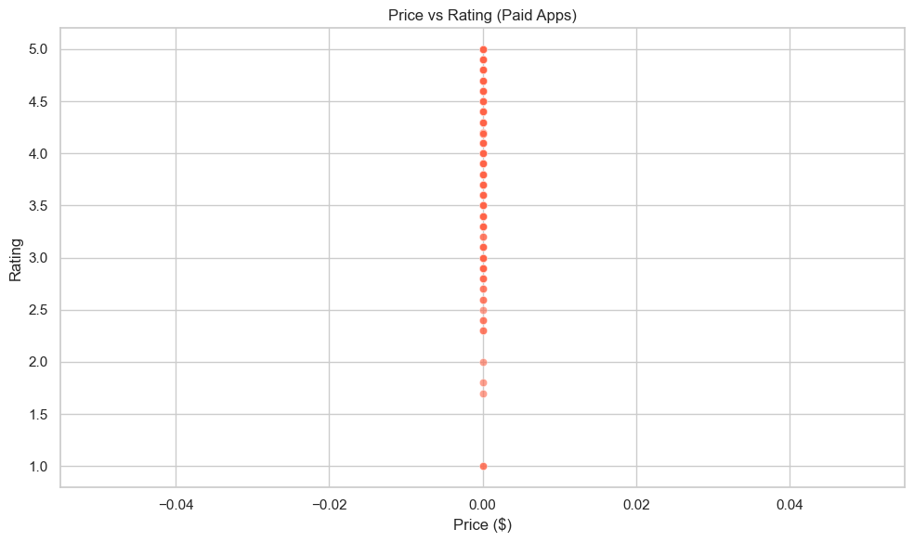
This scatter plot examines the relationship between Price and Rating for Paid Apps.
Prices are nearly zero:
The x-axis ranges from -0.04 to 0.04 dollars, meaning that all paid app prices in the dataset are extremely low or close to zero.
This suggests either a data issue or that most paid apps in the dataset have very small price variations.
Stable rating trends:
The y-axis ranges from 1.0 to 5.0, covering the full range of app ratings.
Since prices barely vary, there is no clear correlation between app price and user rating in this dataset.
Potential anomalies:
The presence of negative prices on the x-axis might be due to data errors or misformatted values.
A more useful approach could involve visualizing ratings against a wider range of price points.
Market implications:
Price elasticity may be minimal for paid apps, as their ratings remain stable regardless of the small price changes.
If price variation is too small, users might prioritize other factors like features, usability, and brand reputation over price.

Slide 17
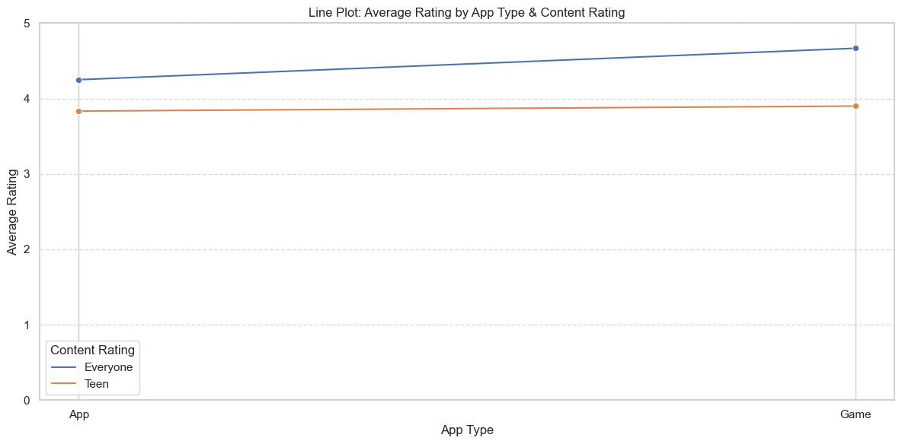
App Type and Ratings:
The plot shows the average ratings for two types of apps: Game and App.
The Game type appears to have slightly higher ratings overall compared to the App type.
Content Rating Differences:
Among Games, the Everyone rating category has a slightly higher average rating than the Teen category.
For Apps, Everyone-rated apps generally receive higher ratings than Teen-rated ones.
Rating Range:
All ratings are within the 0 to 5 range, with no extreme outliers.
This analysis provides a visual overview of how app type and content rating affect average ratings.

Slide 18
Outcomes from the above steps
By Doing the above Steps 1 and 2, we get:
WE can see the columns such as Apps, Categories, Ratings, Reviews, size, installs, types, price, content ratings, genres, last updated, current versions, and Android versions.
Datatypes of the dataset columns are object & float.
There are 10841 rows & 13 columns.
The only columns that have null values are App, Ratings, Type, Content rating, Android version, and current version.
The duplicate values were also present in the dataset and the float values were converted into numeric.
Only the last update and price were dropped from the dataset.
Null values were filled with mean and MB size was Converted To kB.
Boxplots were made for outlier detection but only Review column outliers were dropped.
IQR was calculated and the last step EDA was done on the dataset.
IN eDA graphs & plots were made to compare & to derive insights from the dataset.

Slide 19
Tools Used
Python – Main programming language for analysis
Pandas – For data loading, cleaning, manipulation, and exploration
NumPy – For handling numerical operations and arrays
Matplotlib – For creating static data visualizations
Seaborn – For advanced, aesthetic, and statistical plots
Jupyter Notebook – Interactive environment for code execution and visualization
Regular Expressions – Used for cleaning and transforming string data like price, installs, and size columns

Slide 20
Outcome & Insights
Most apps are free, and users tend to prefer free apps with good ratings and functionality.
The average rating of apps falls between 4.0 and 4.5, indicating overall positive user feedback.
App category and type significantly influence the number of installs and ratings.
Free apps get more downloads but may have slightly lower average ratings compared to paid ones.
Some outliers and missing values in the dataset had to be removed or handled for clean analysis.
Visualizations helped identify trends like popular categories, user preferences, and genre-specific performance.
Strengthened practical skills in Python-based EDA, data preprocessing, and data visualization using Pandas, Matplotlib, and Seaborn.

Slide 21
Conclusion
Through this project, we successfully explored and analyzed various aspects of apps on the Google Play Store. We observed that:
Free apps dominate the platform.
Categories like Tools, Family, and Communication are highly popular.
App ratings, reviews, and installs are interconnected indicators of performance.
Data cleaning played a crucial role in making the analysis meaningful.
The project reinforced key EDA techniques and Python skills relevant for real-world data science tasks.
This analysis can assist developers and businesses in understanding what drives success on the Play Store and help in strategic app development and marketing.

